Slide 1
Train and Deploy models with Azure AUTOML
Leonard Püttmann
Data Scientist at Kern AI

Slide 2
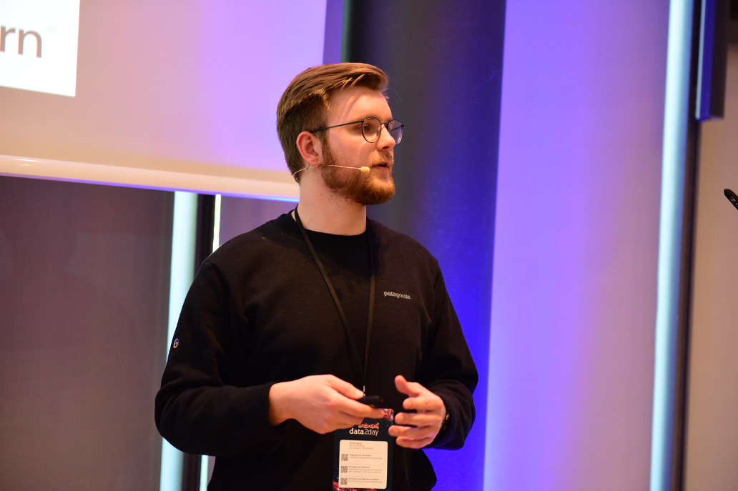





About me
Background in economics
Data Scientist at Kern AI
Mainly working with NLP, big interest in cloud computing
Leonard Püttmann
github.com/LeonardPuettmannKern

Slide 3

About me
DP-100 | Azure Data Scientist Associate certified

Slide 4
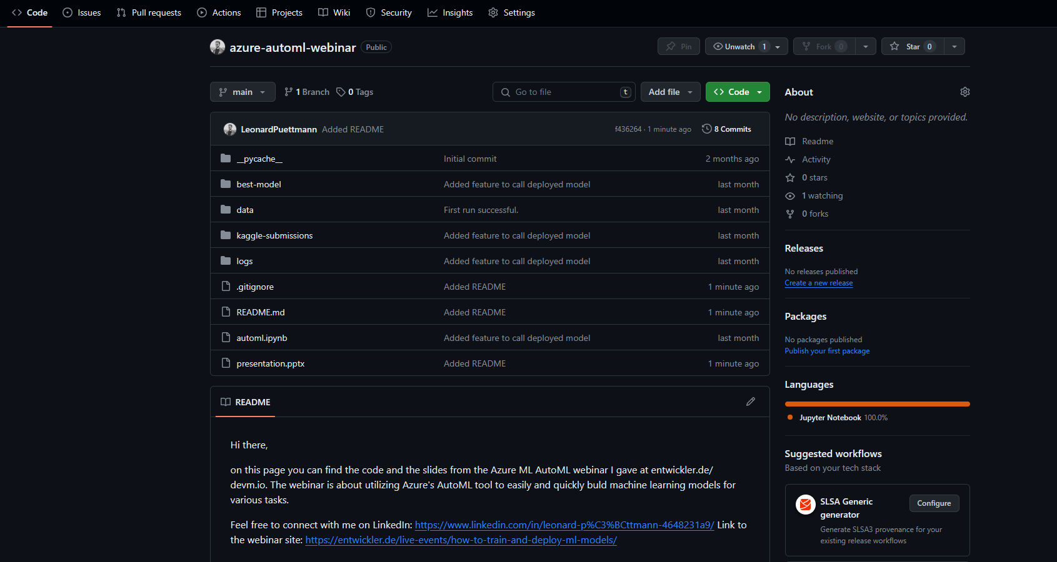
Slides & code
You can find all the code & slides on my GitHub:
github.com/LeonardPuettmann/azure-automl-webinar

Slide 5
AGENDA
- What is AutoML & when to use it
- When to move AutoML to the cloud
- Azure ML basics
- Authentication & Python SDK
- Compute basics
- Training a model with AutoML for a Kaggle competition
- Inspecting the models
- Deploying & predicting with Azure (Auto)ML models

Slide 6
What is AutoMl?
And when should you use it?

Slide 7
What is AutoML
Automated machine learning is the process of automating the time-consuming, iterative tasks of machine learning model development.

Slide 8
What is AutoML
It allows data scientists, analysts, and developers to build ML models with high scale, efficiency, and productivity all while sustaining model quality.
What is automated ML? AutoML - Azure Machine Learning | Microsoft Learn

Slide 9
What is AutoML

Slide 10

What is AutoML
Professionals
Experienced developers

Slide 11
What is AutoML
Professionals
Experienced developers
Production

Slide 12
What is AutoML
Professionals
Experienced developers
Students
New developers
Production

Slide 13
What is AutoML
Professionals
Experienced developers
Students
New developers
Production
Testing/ Learning

Slide 14
Automl vs Hpo
Hyperparameter Optimization
Automated
Machine Learning
Improving and finding the best Hyperparameters of a single model type to improve performance
Feature engineering and transformation, finding the best type of model. Broader approach to the whole ML pipeline.

Slide 15
Moving AutoML to the Cloud
Annual revenue growth

Slide 16
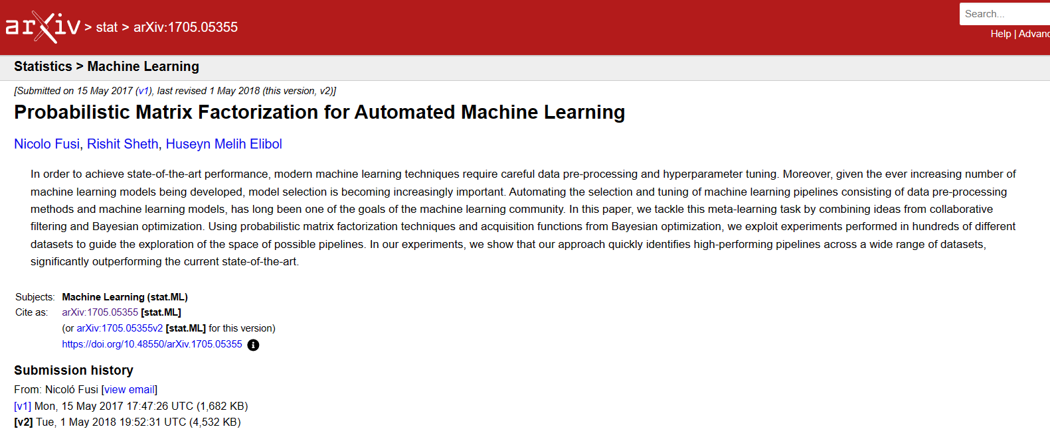
What is Azure AutoML
Highly scalable
Easy to use -> Azure ML Studio
Accurate for many use cases
[1705.05355] Probabilistic Matrix Factorization for Automated Machine Learning (arxiv.org)

Slide 17




Available for many different tasks
Regression
Classification
Computer
Vision
Natural Language Processing

Slide 18
Some Azure ML Basics
Authentication, Compute & more

Slide 19
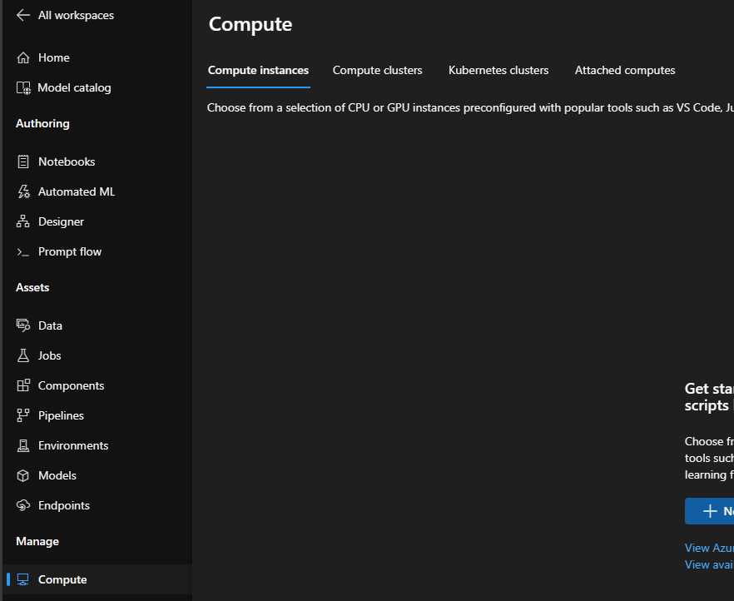
Let’s talk about compute
At the moment, there are four types of compute in Azure ML. For AutoML, two of these are mainly of interest to us:
- Compute instances (i.e VMs)
- Compute cluster

Slide 20

Compute Instances
Virtual machines that we can deploy via Azure ML. There are many different types of compute instances available.
They are mainly use to:
- Train ML models
- Usage in Python notebooks
- Inference/ deploying models

Slide 21

Compute Clusters
Allows you to deploy multiple nodes of compute instances mainly managed and orchstrated by Azure. They are automatically scaalable.
They are mainly use to:
- Train ML models
- Run pipelines and jobs, for example..
- AutoML jobs!
Automatic scaling
1 node
5 node
There are also „low priority“ nodes available, which are super cheap!

Slide 22
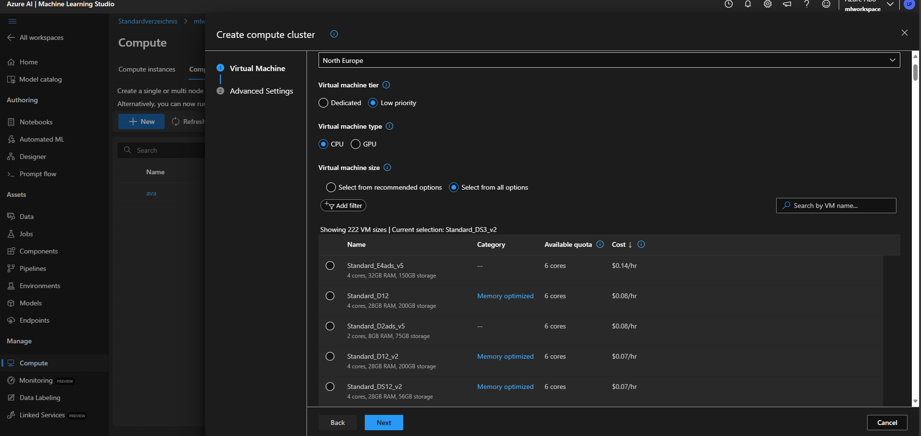
Compute Clusters

Slide 23
Compute Clusters
At the moment you can only get one node for the low priority clusters.

Slide 24
Compute Clusters
Automatic scaling
0 nodes
Idling compute clusters can scale to 0 and stop costing you money.
n nodes

Slide 25
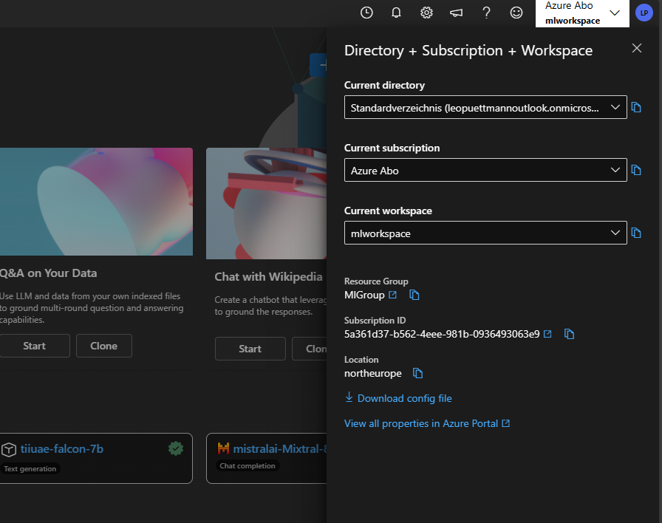
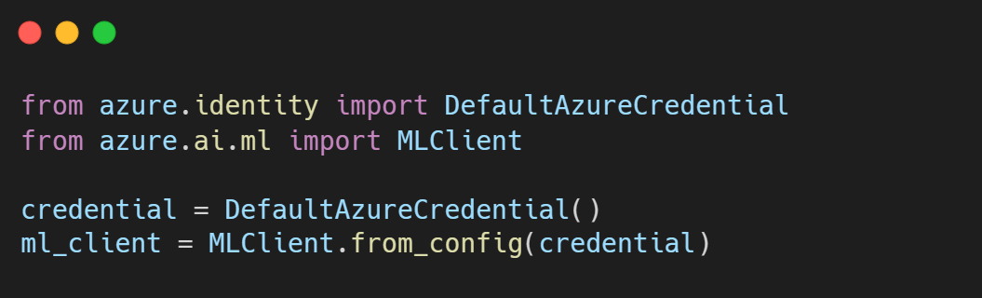
Authenticating in Azure ML SKD V2 for Python

Slide 26
Training a Model
With Azure AutoML

Slide 27
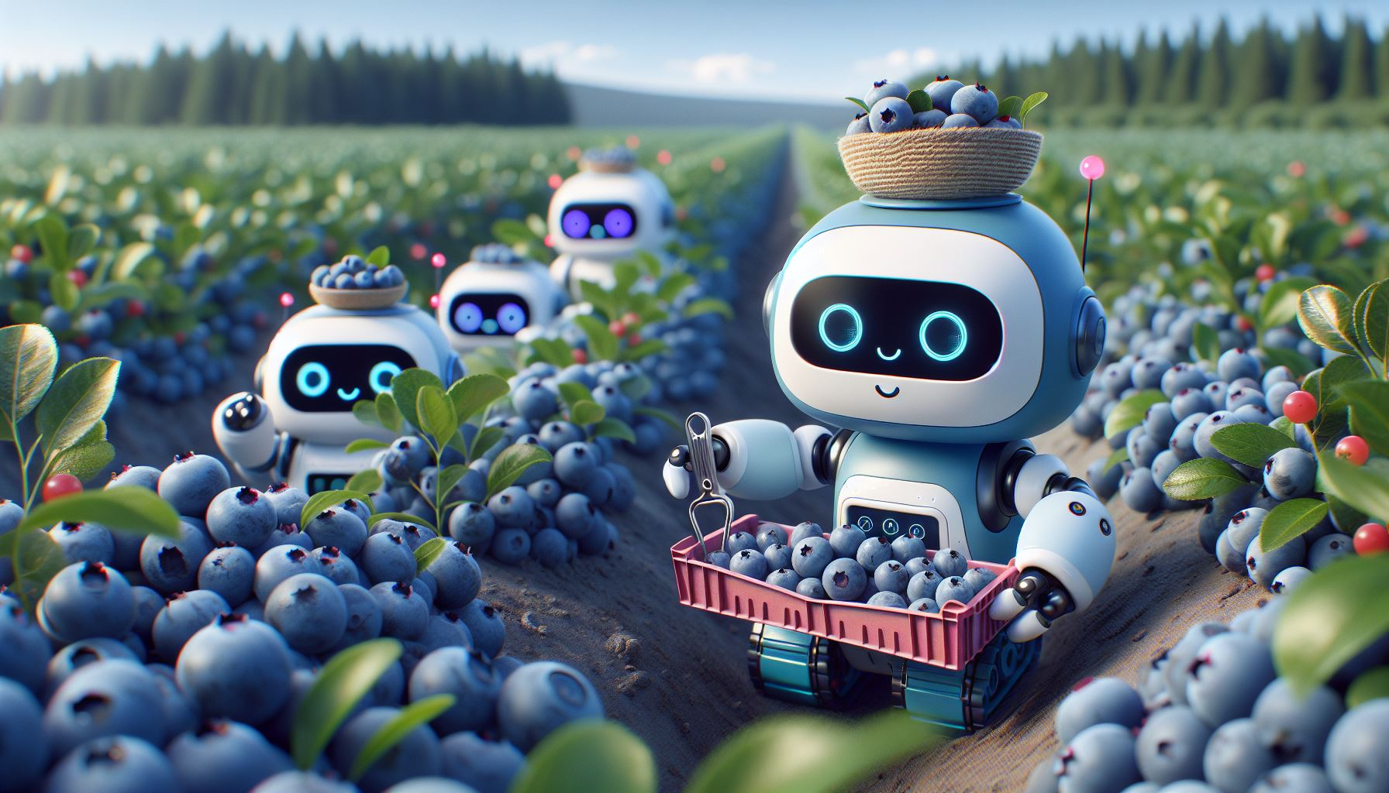
The dataset
Today we’ll use AutoML to predict the yield for a Blueberry farm based on things like rain or insect population!

Slide 28
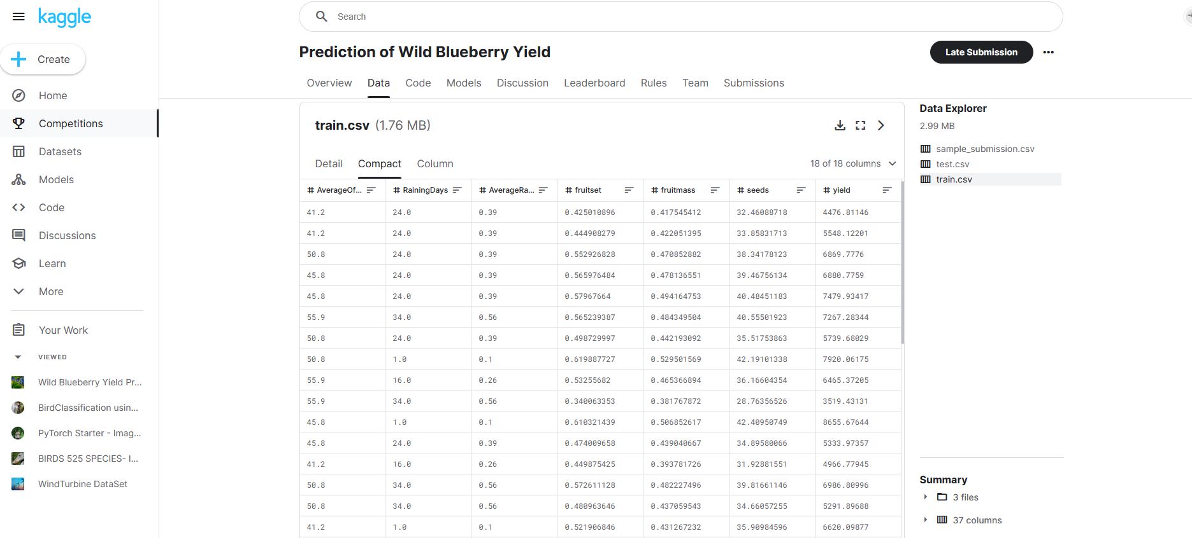
The dataset
You can find the dataset on Kaggle:
Prediction of Wild Blueberry Yield | Kaggle

Slide 29
Hands-on
Let’s switch to our Notebook and the Azure ML Studio! ☺

Slide 30
Creating a dataset in Azure ML

Slide 31
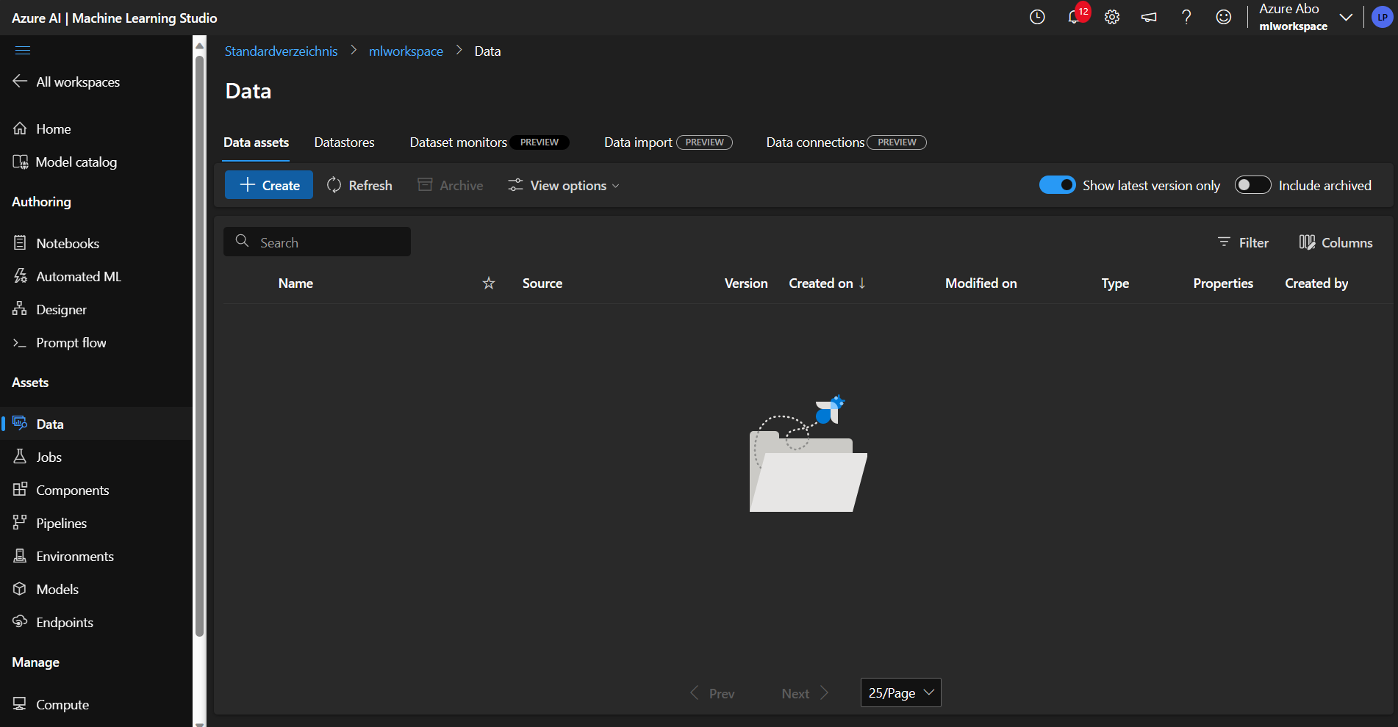
Creating a dataset

Slide 32
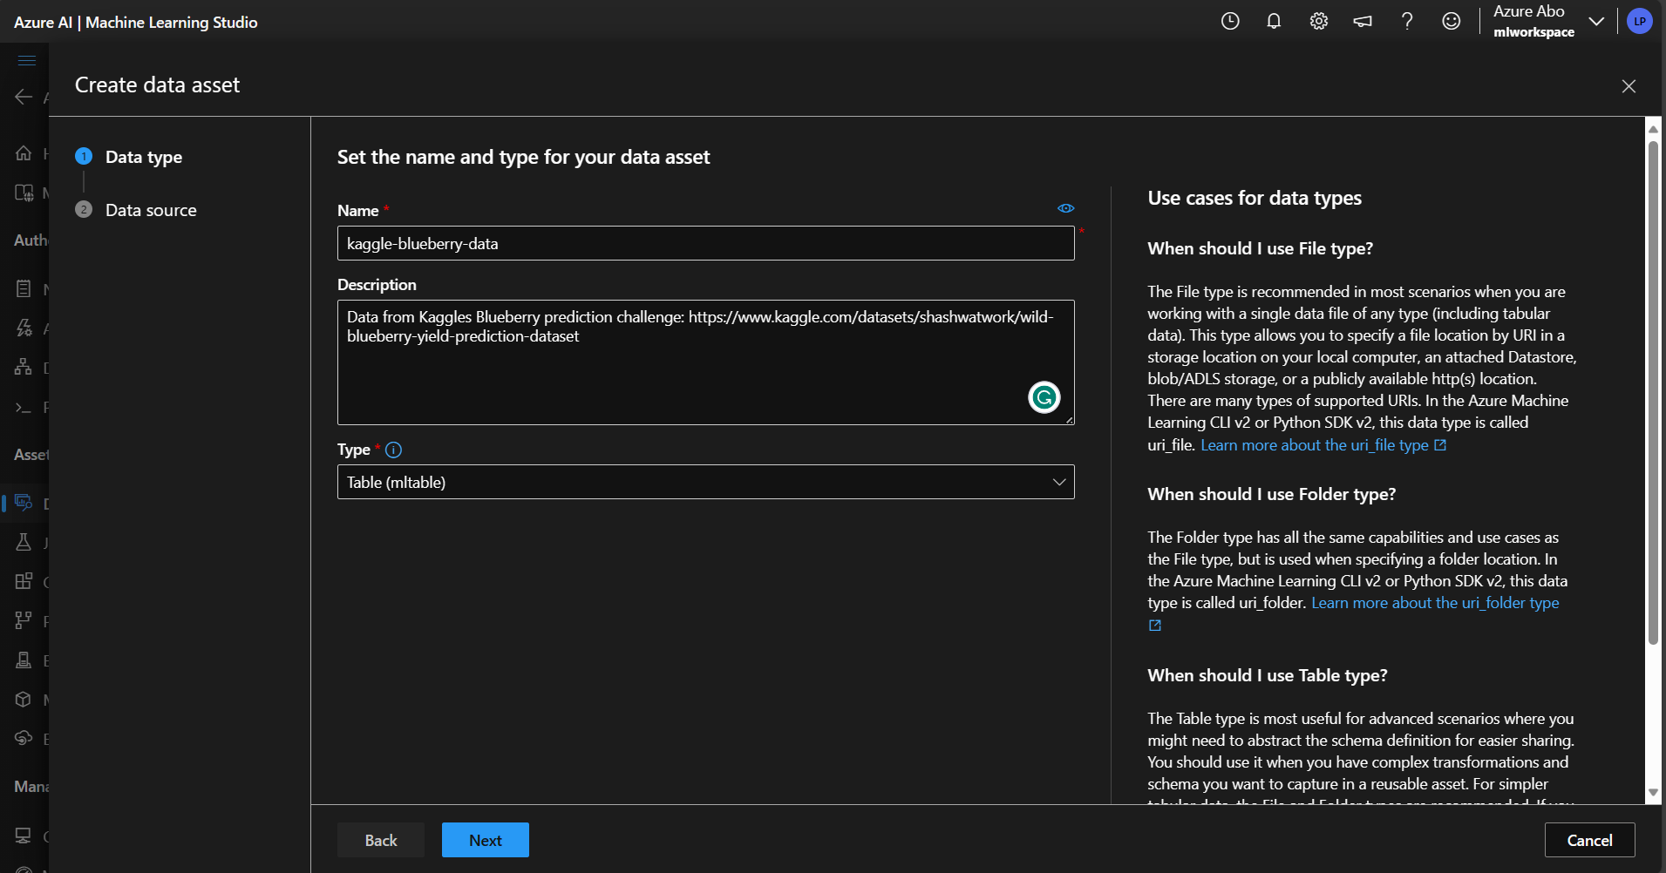
Creating a dataset

Slide 33
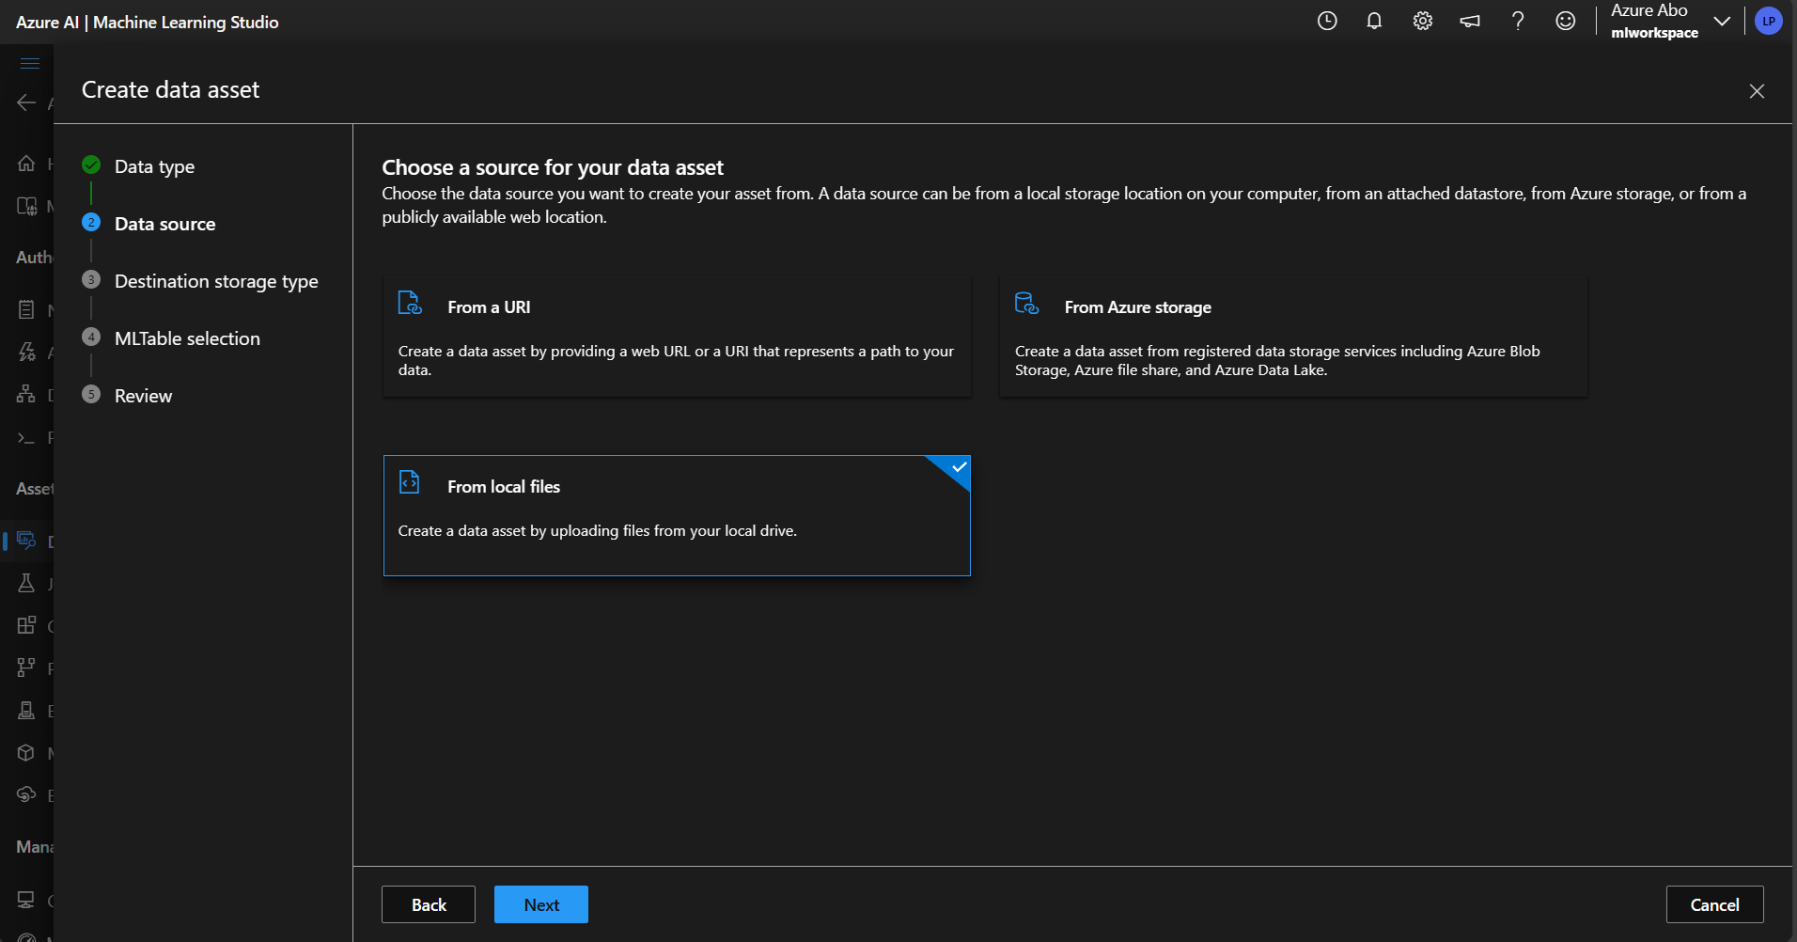
Creating a dataset

Slide 34
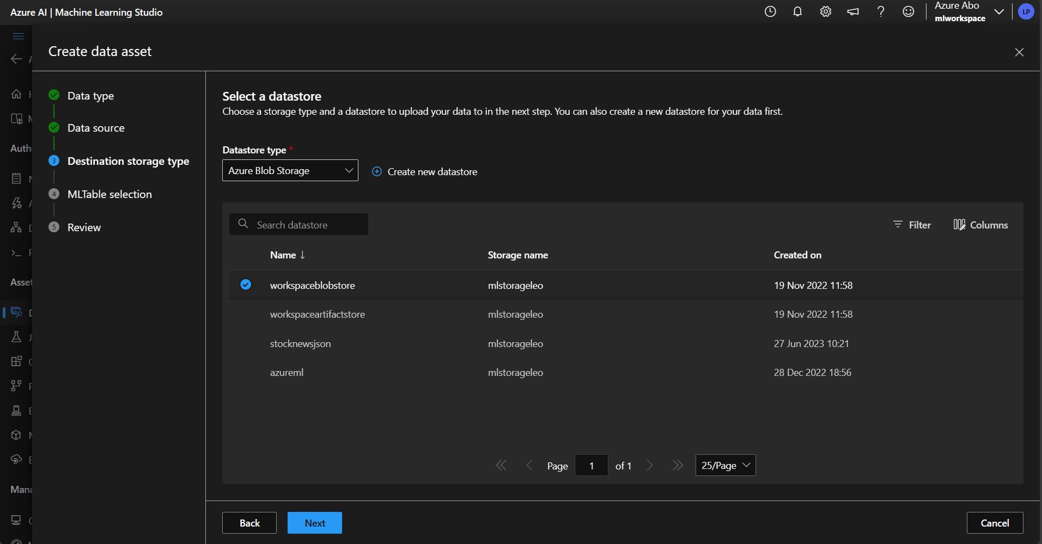
Creating a dataset

Slide 35
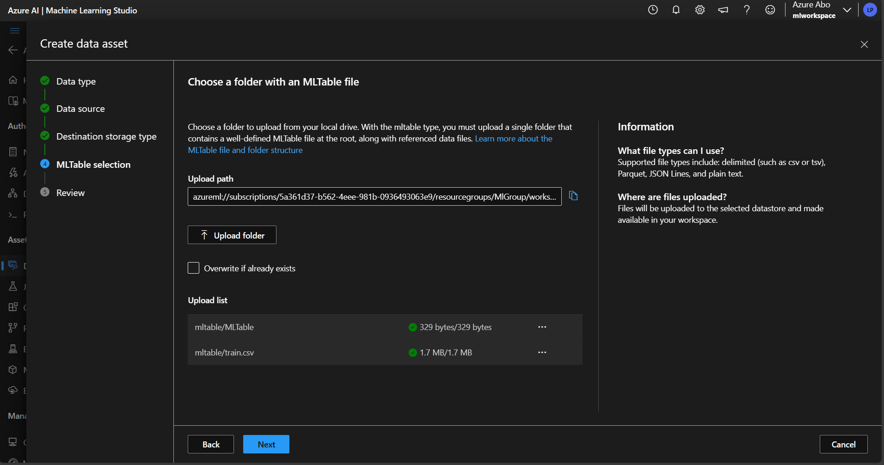
Creating a dataset

Slide 36
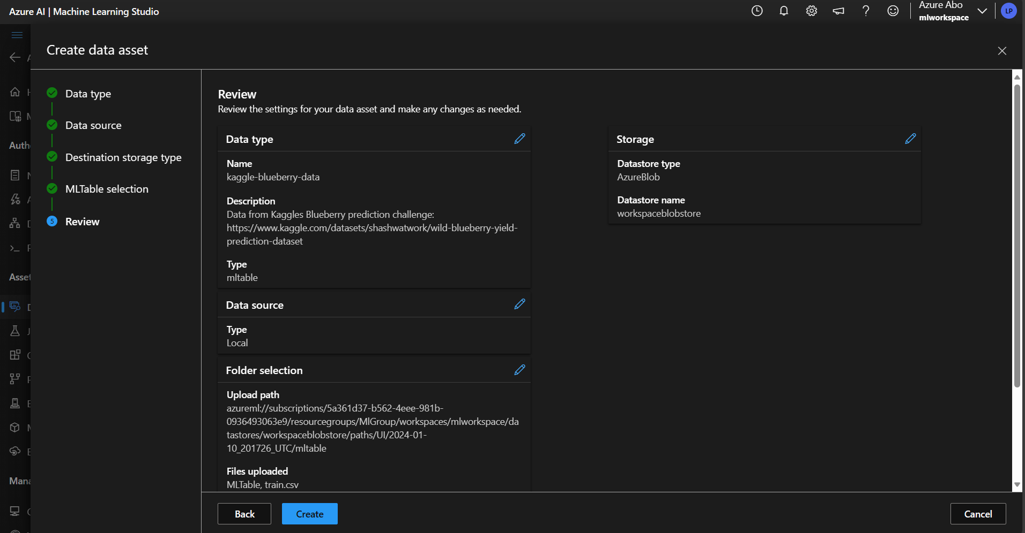
Creating a dataset

Slide 37
Creating An Auto ml job for our dataset

Slide 38
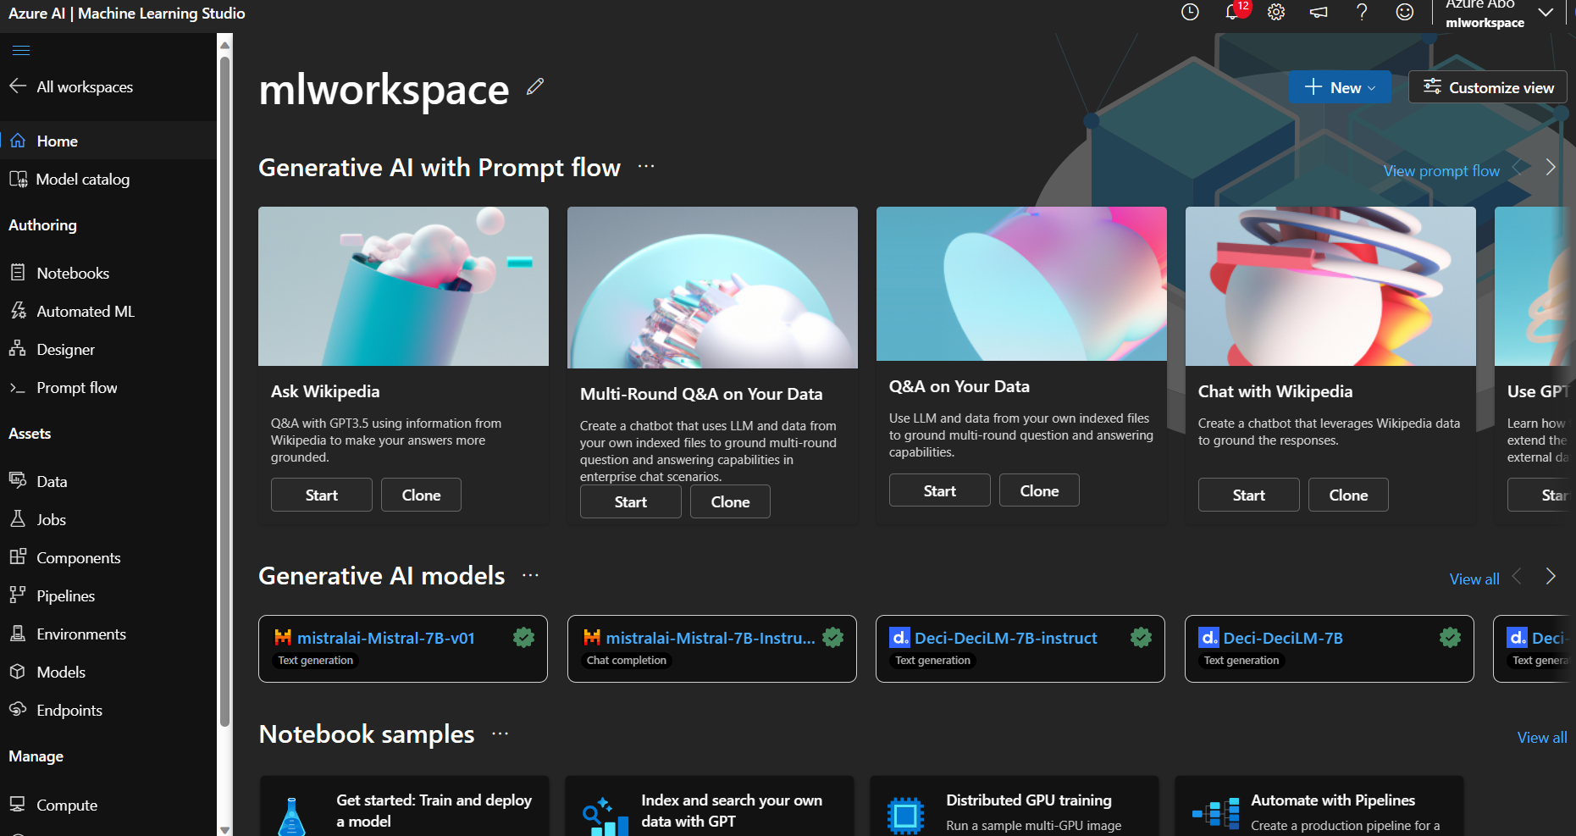
Hands-on

Slide 39
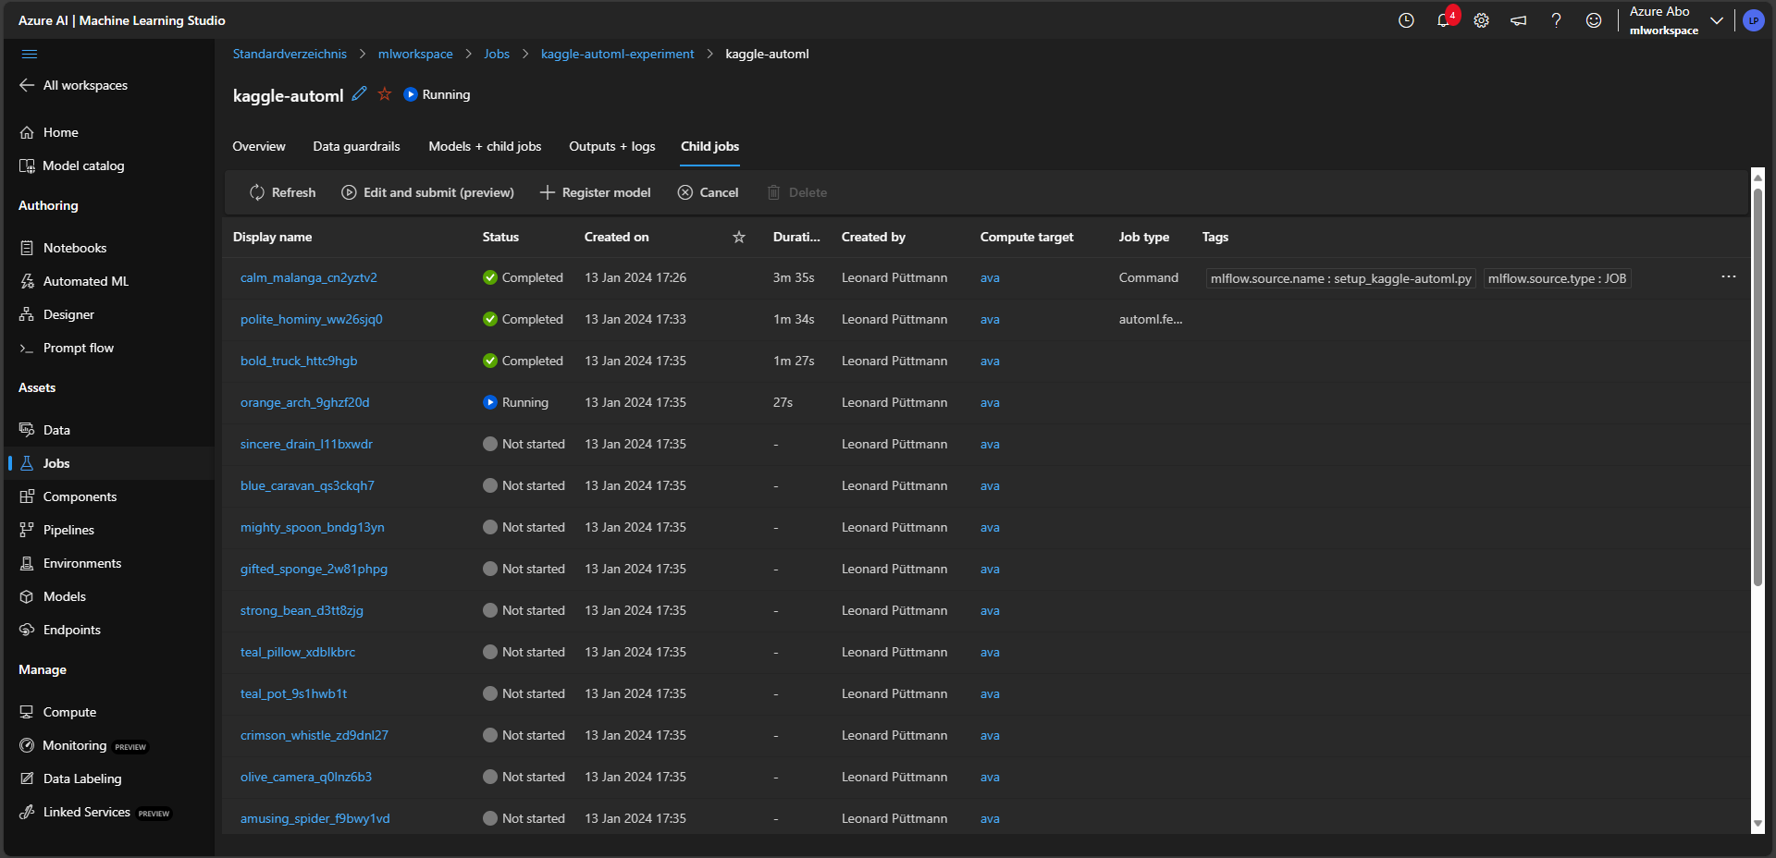
Hands-on

Slide 40
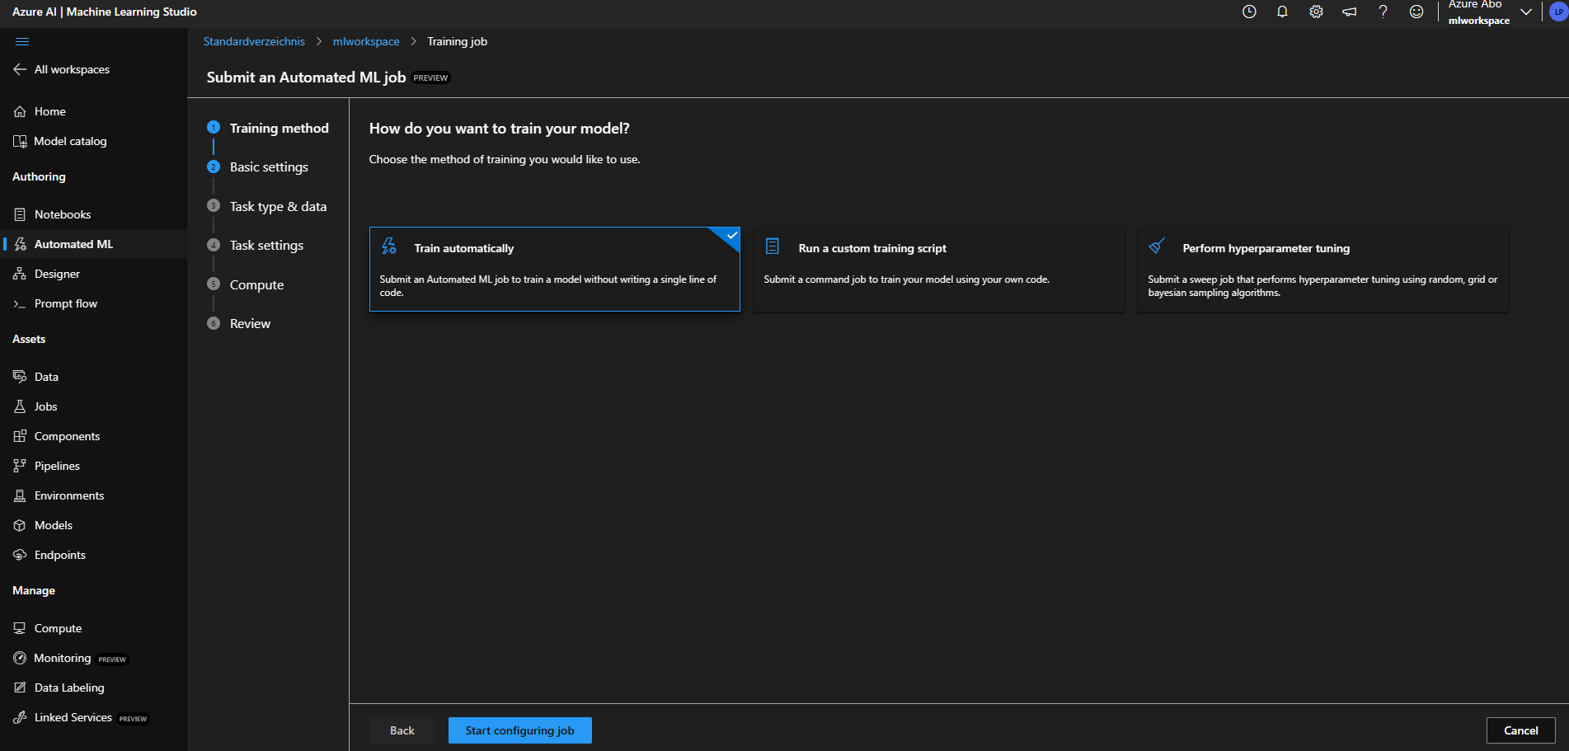
Hands-on

Slide 41
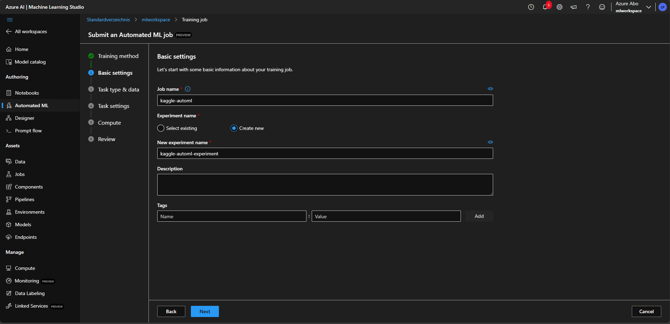
Hands-on

Slide 42
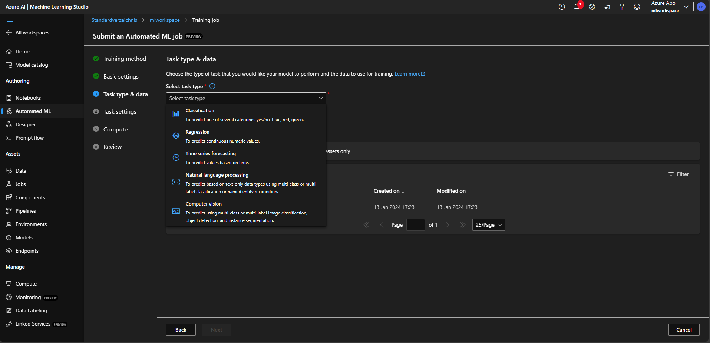
Hands-on

Slide 43
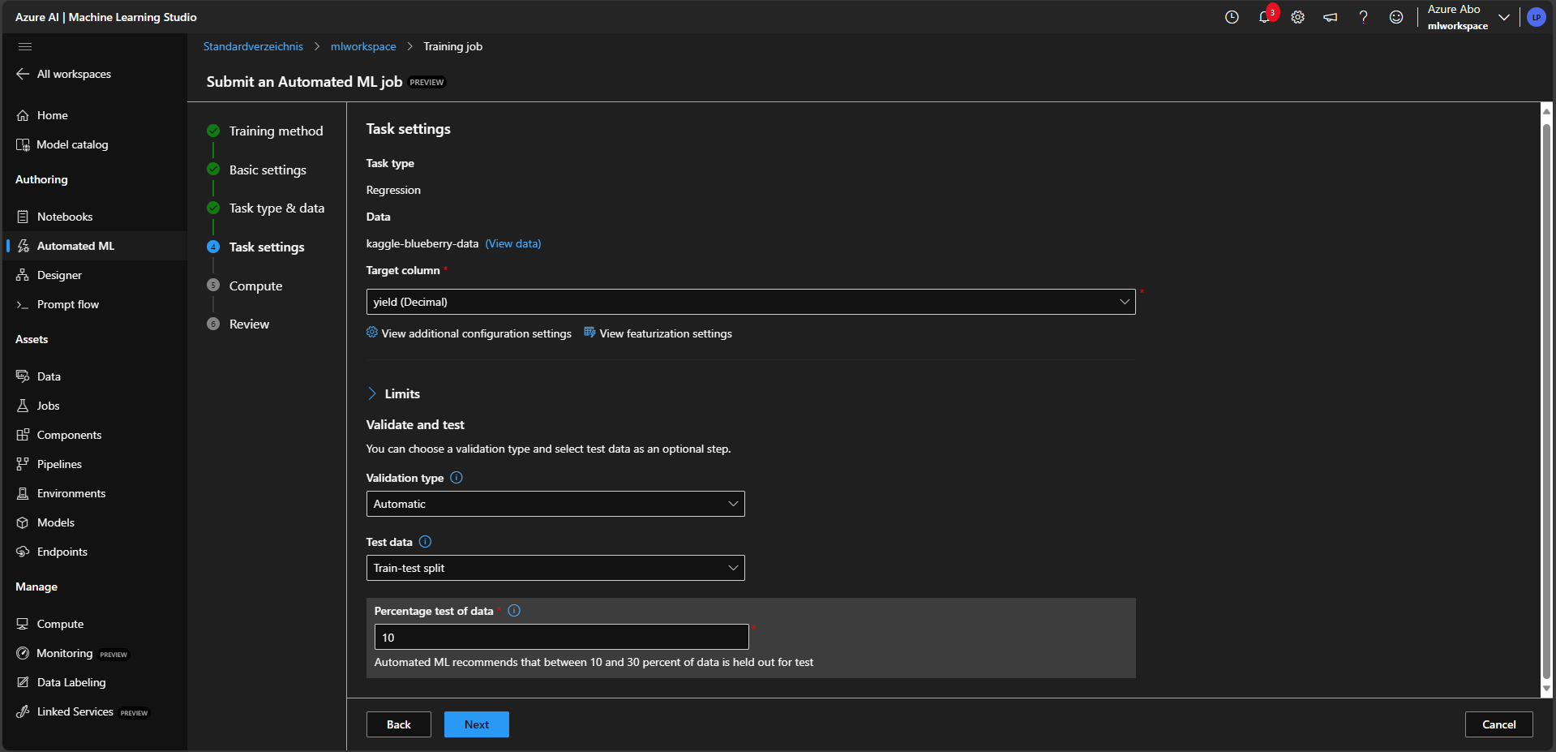
Hands-on

Slide 44
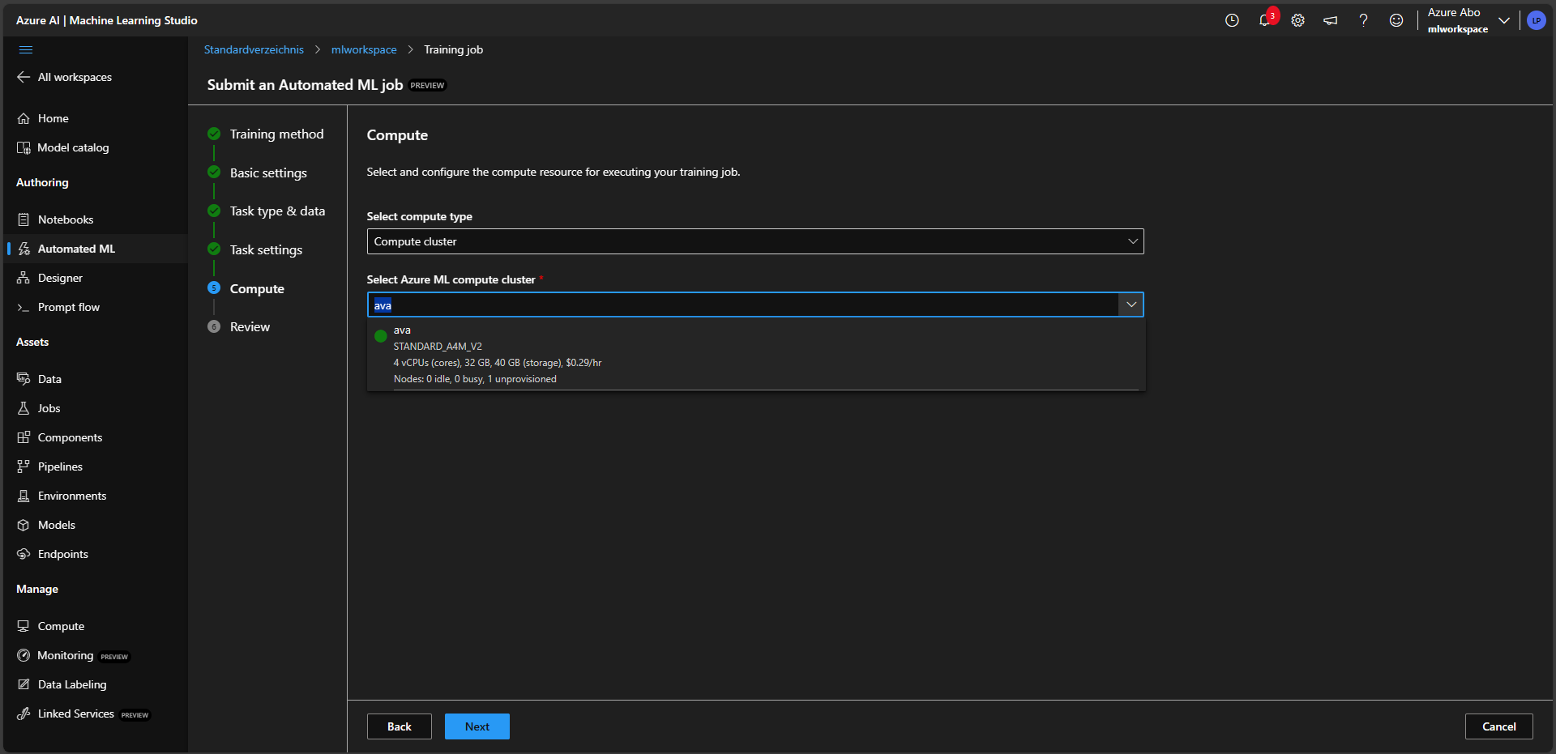
Hands-on

Slide 45
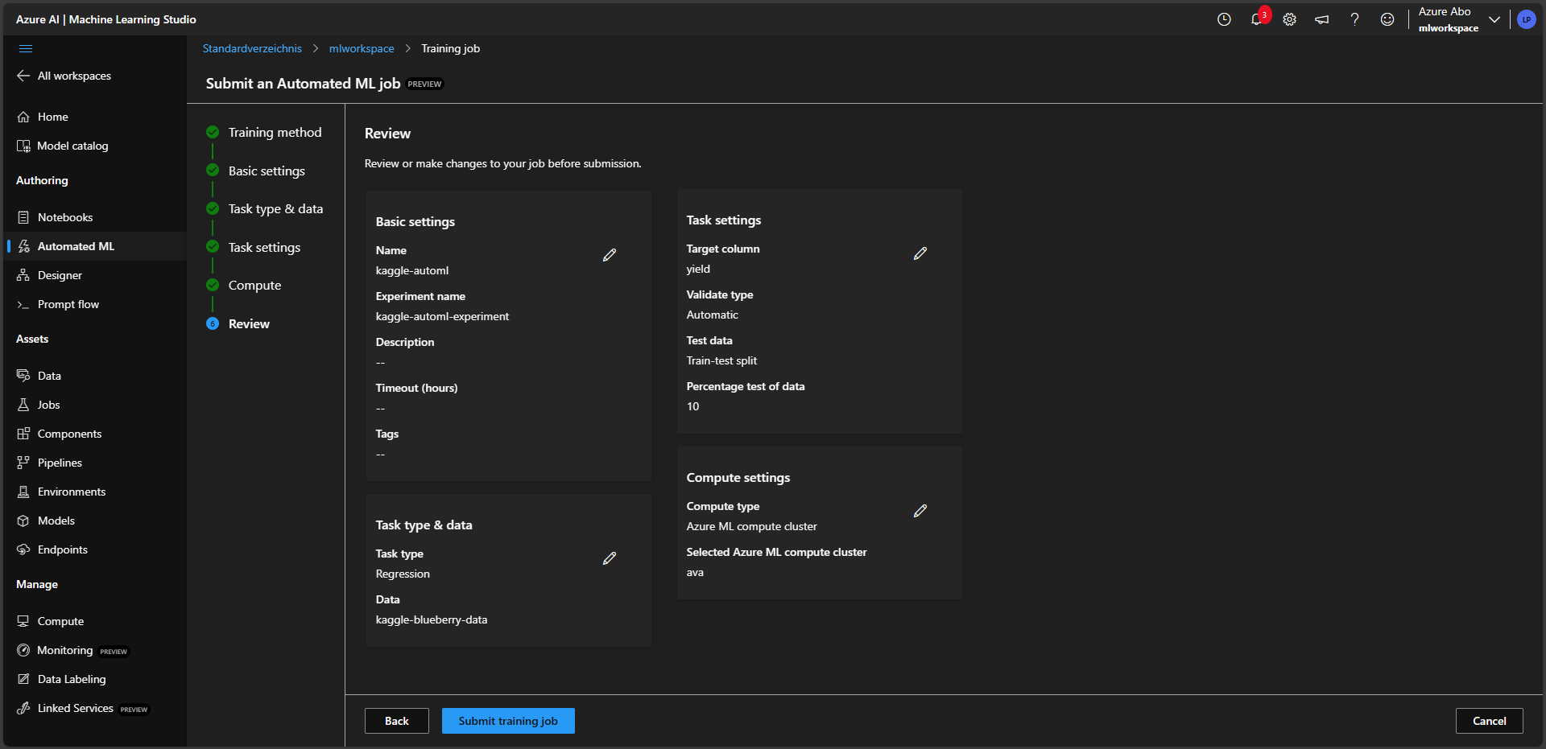
Hands-on

Slide 46
Understanding and deploying the best run

Slide 47
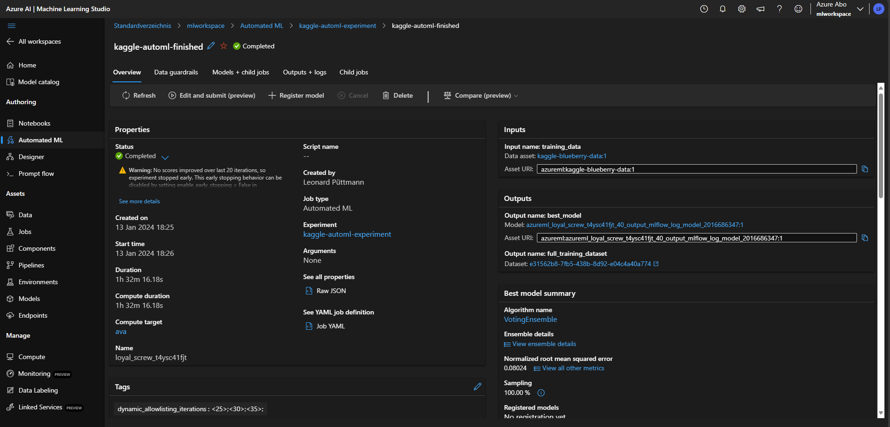
Hands-on

Slide 48
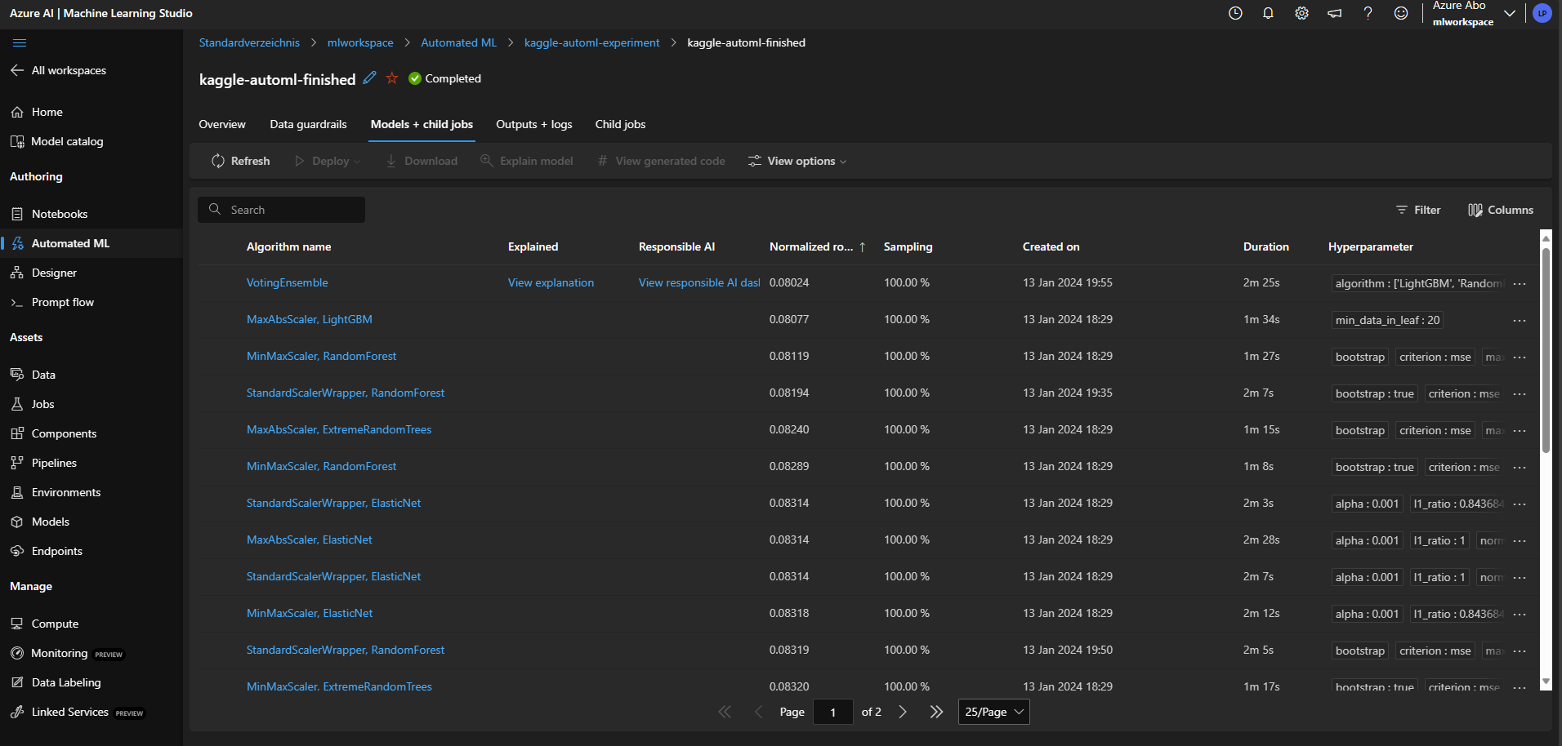
Hands-on

Slide 49
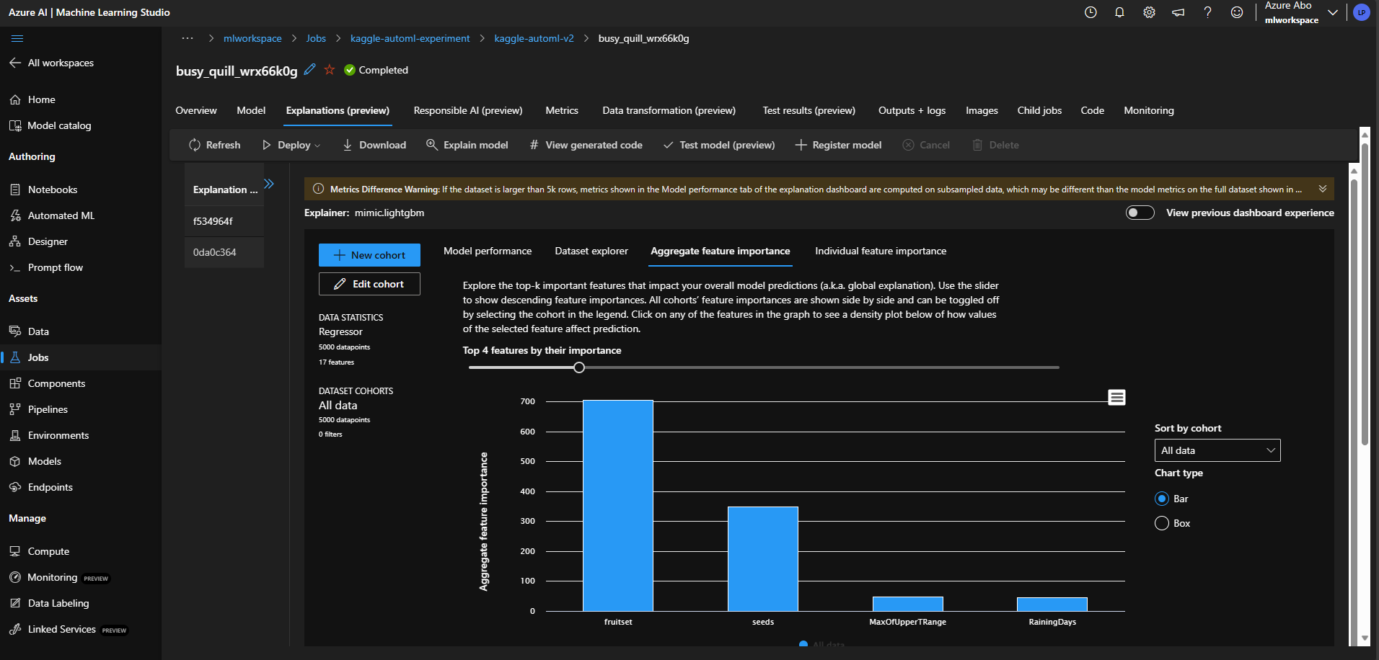
Hands-on

Slide 50
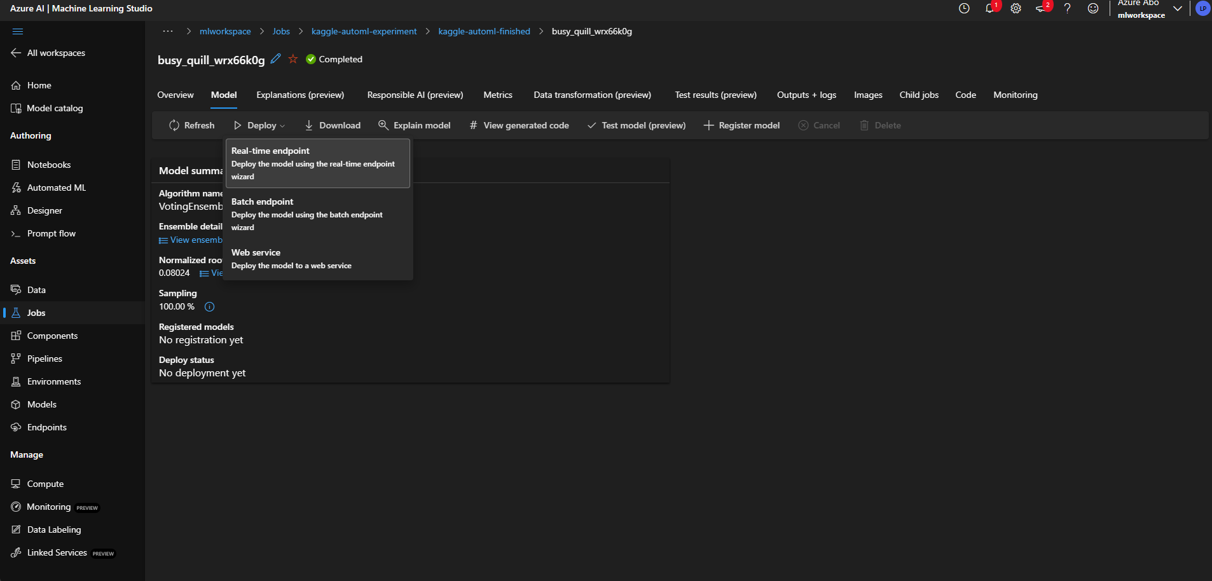
Hands-on

Slide 51
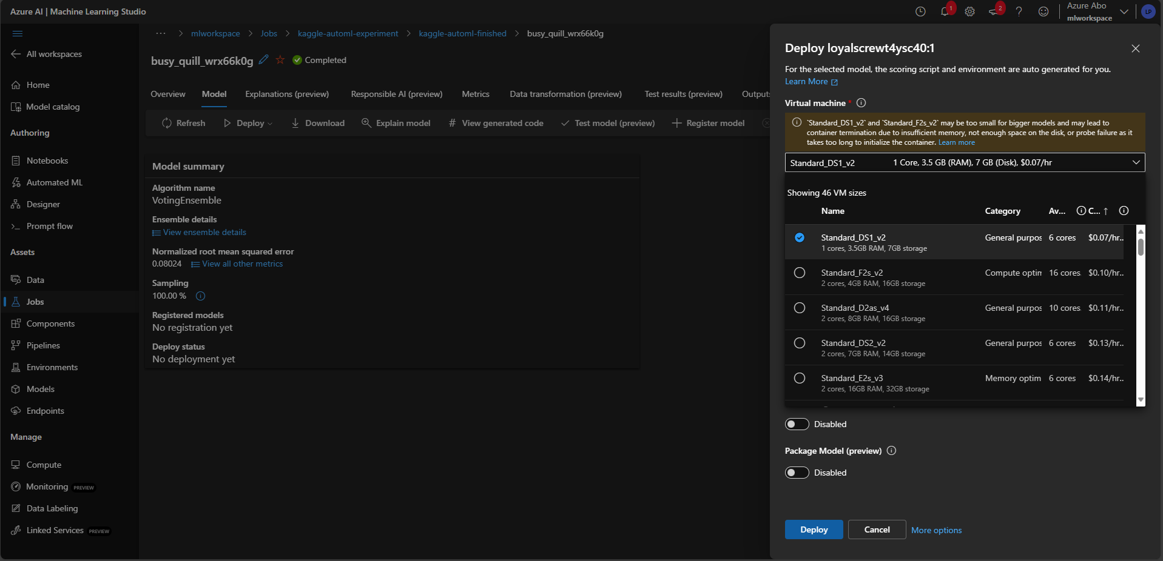
Hands-on

Slide 52
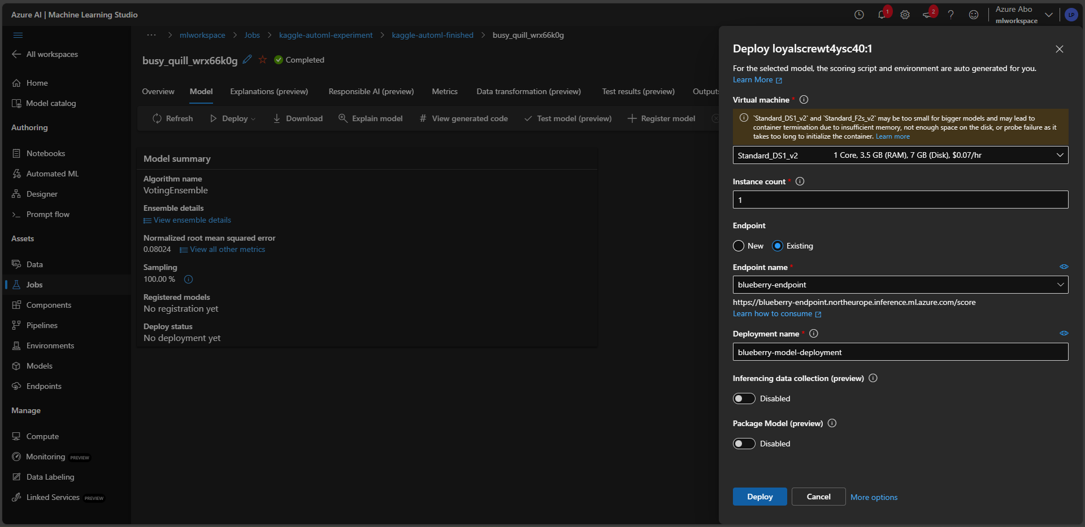
Hands-on

Slide 53
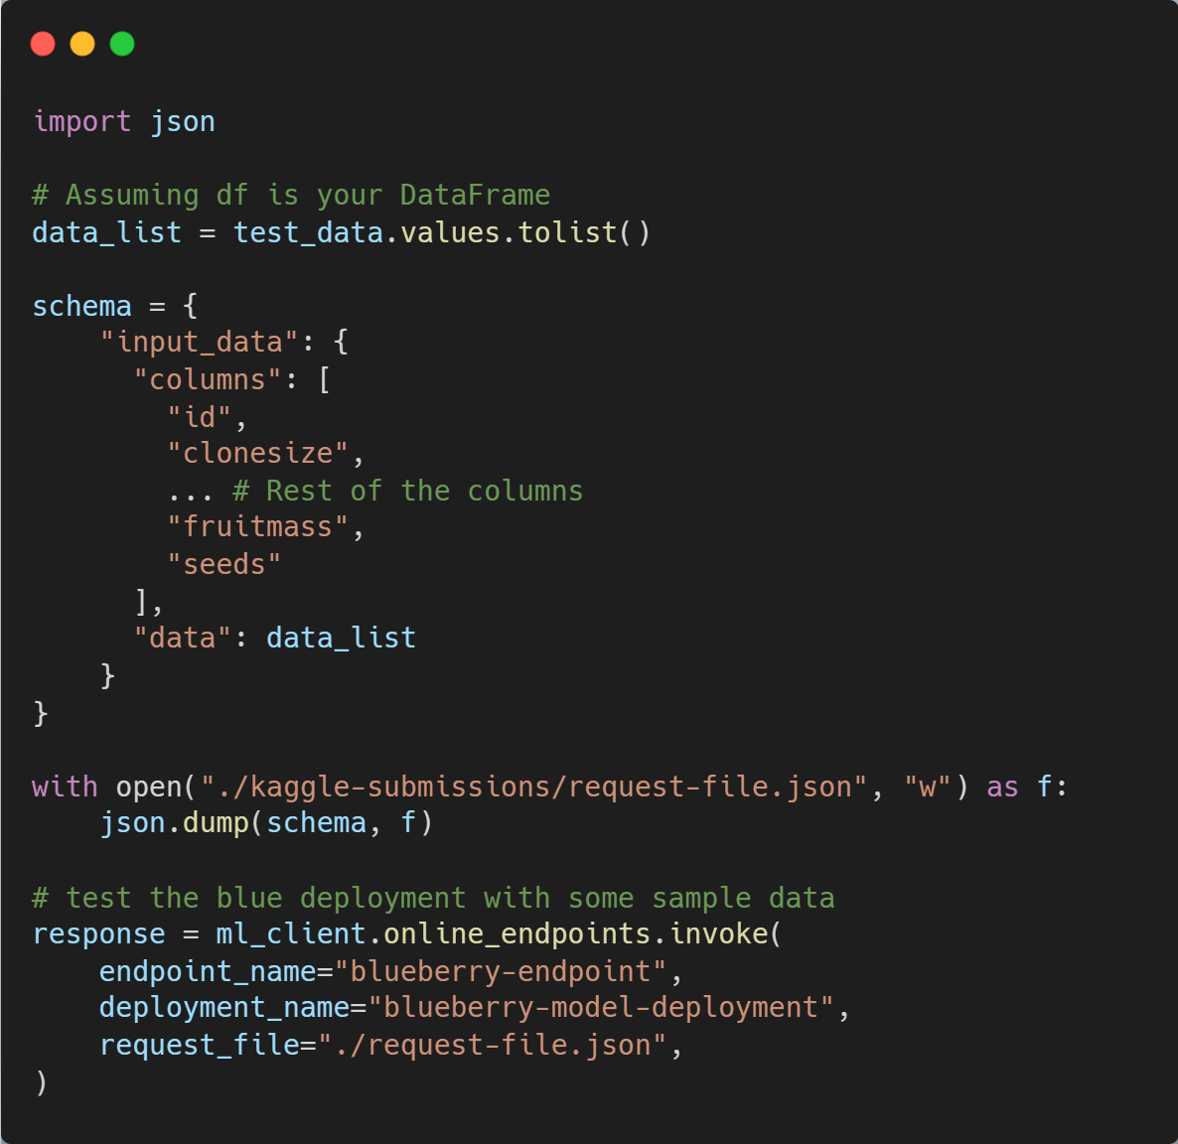
Consume the deployed model
First we create a JSON file with the data we need for the submission.
We send the JSON to the deployed model and get the predictions as a response.

Slide 54
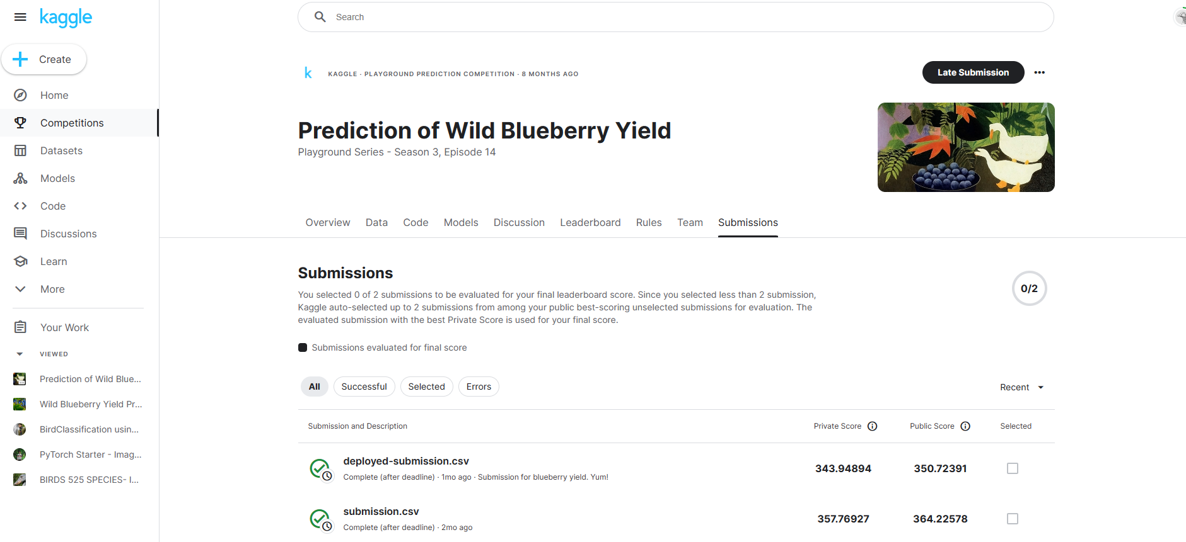
Consume the deployed model

Slide 55
Thank you for your attention! ☺
Feel free to stay in touch
Leonard Püttmann
github.com/LeonardPuettmannKern

